Slide 1
American Airlines
PowerPoint Template
July 2022
Privileged & Confidential

Slide 2
Table of Contents
Intro
Table of Contents
Guidelines
Master Slides
General
Dividers
Imagery Focused
Data
Copy Focused / Blank
Project Mapping
Closers
Example Deck
Example Tables/Graphs

Slide 3
Template Guidelines
Ensure fonts and colors used follow the American Airlines brand guidelines
When possible, ensure font size is no less than 14pt
Avoid placing content over logos, including Flight Symbol
As much as possible, maintain slide structure as outlined in template and examples
American color palette

Slide 49
American Airlines
PowerPoint Template
Example deck
Privileged & Confidential

Slide 50
Agenda
Meeting for uniform confirmation start date
Receive and distribute uniforms to employees
1
5
Survey with Flight Attendants regarding new uniform options
Confirm all employees have received updated uniforms
2
6
Confirm final uniform decisions
Meeting with employees regarding uniforms/Put new uniform wearing into action
3
7
Confirm product of final uniforms
4

Slide 51
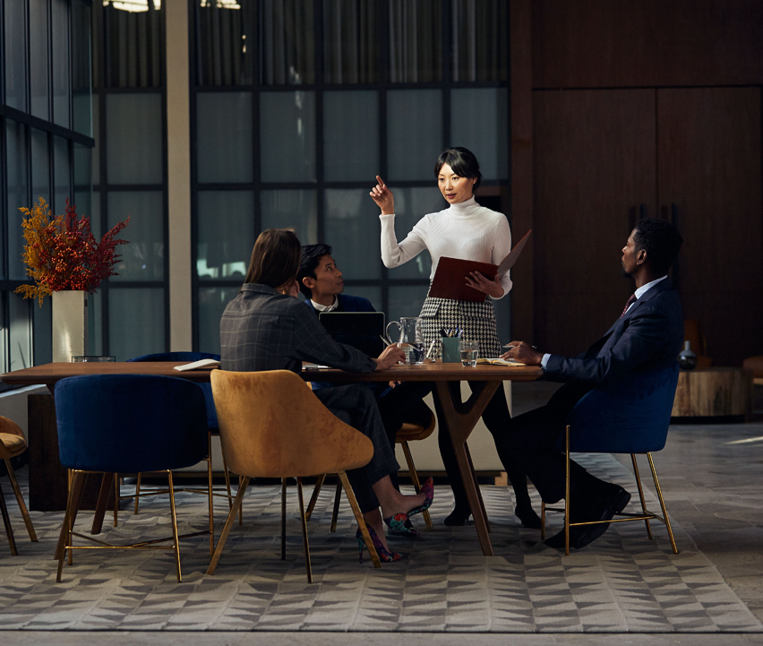
It takes
a village

Slide 52
Land’s End
4Q19 Launch
During the January 9th meeting, you voted to “adopt & go” the current Twin Hill designs to facilitate a quicker rollout/implementation.
Meaningful fit changes/modifications will be made to ensure Twin Hill fit issues.
In addition to fit improvements, the following improvements will be incorporated into the Phase I rollout:
Suiting color change – Aviation Blue
New look shirting/ties/scarf designs
An added bonus to the color/shirting/accessory changes: it ensures visual differentiation between the TH collection vs LE collection.

Slide 53
Questions
You may also write questions by email

Slide 54
New designs are here!

Slide 55
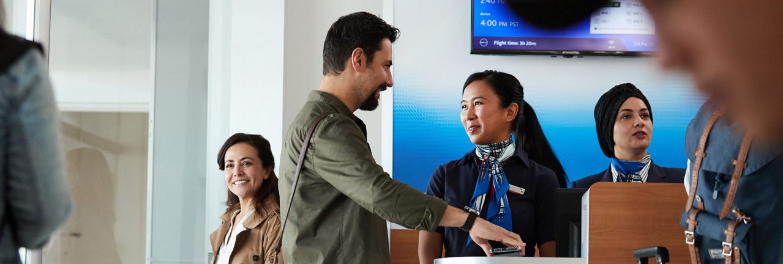
Shirt Updates
The Lands’ End design team has been working hard since April to create new and exciting designs that offer visual differentiation while maintaining a signature cohesive look.
The construction, fit and fabrication will be identical to the shirting shown in April.
We heard you loud and clear…shirting and neckwear did not add enough differentiation between job roles and was not a signature look exclusive to American.

Slide 56
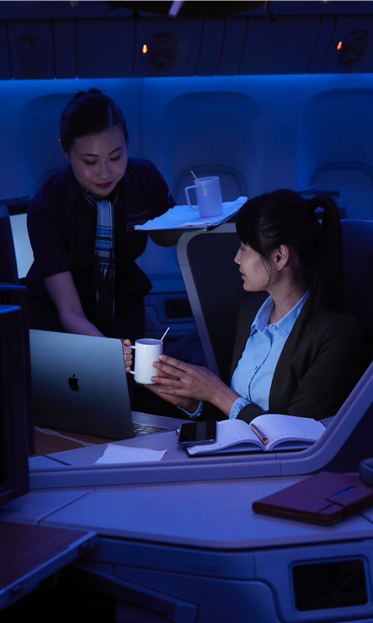
Preparing
Continued design refinement for Phase II items:
Signature dresses
Signature outerwear
Untucked blouse options
Knitwear
Since we met in April, the team has been hard at work. Here is a glimpse of what has been accomplished:
Design Work: Incorporated your feedback that the shirting and neckwear needed to have more differentiation between work groups and look visually different than the current collection.

Slide 57
“Happiness is looking down on your next destination from your plane window.”
John Doe, Travel Journal

Slide 58
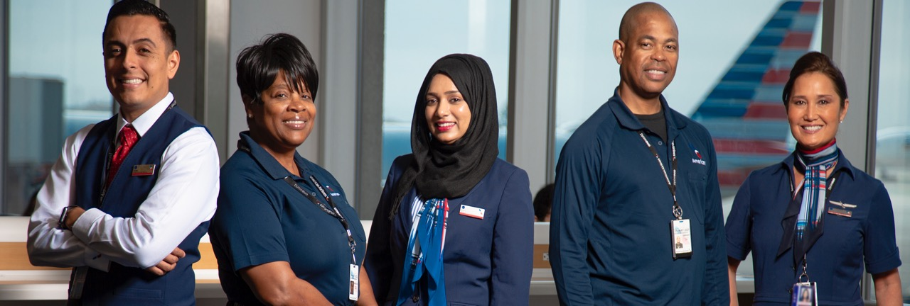

Slide 59
What’s Next
Physical samples in correct fabrics and colors will be made and shown in our next meeting.
From those samples, you will pick the top two that will be field tested after Phase I rollout is complete.
From the Field Test, a final signature dress will be picked.
The panel dress will also be offered in conjunction with the signature dress.

Slide 60
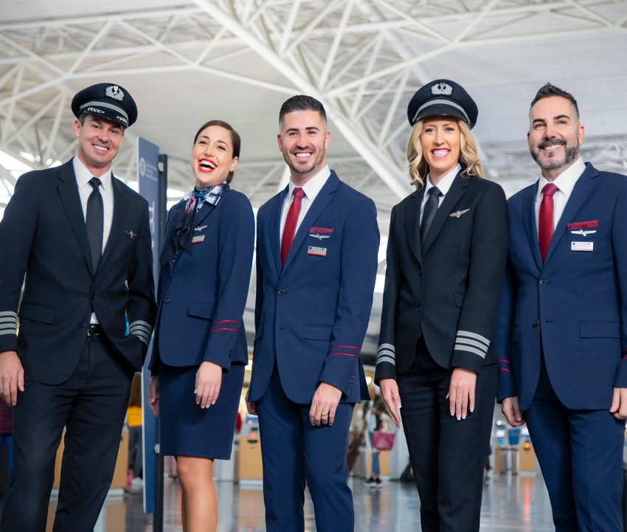
Color Block Dress
Fabric: light weight ponte knit with stretch
Wrap dress inspired; secured at top
Invisible zipper at side seam
Relaxed fit with contoured seam for shaping

Slide 61
We have four voting options
for our new clothing looks.

Slide 62
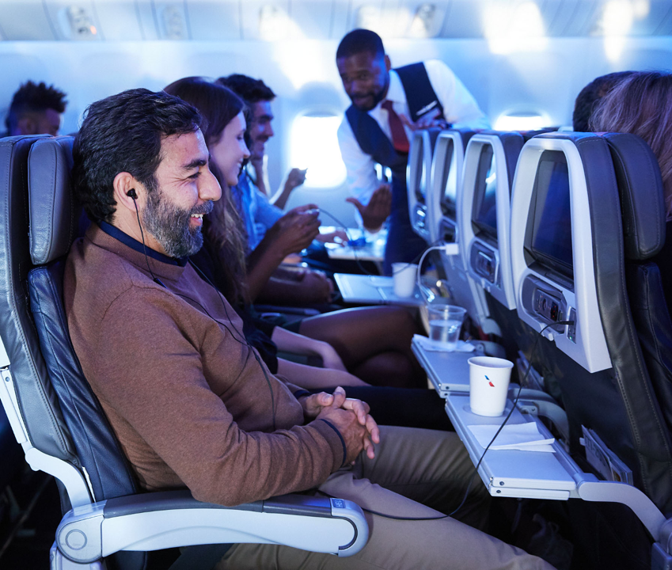

Slide 63

Welcome!
This is a paragraph break

Slide 64
Timeline
January 1, 2020
Place brief description here..
January 1, 2020
Place brief description here..
January 1, 2020
Place brief description here..
January 1, 2020
Place brief description here..
January 1, 2020
Place brief description here..
January 1, 2020
Place brief description here..
January 1, 2020
Place brief description here..
January 1, 2020
Place brief description here..
January 1, 2020
Place brief description here..

Slide 65
Timeline
Q1-Q3
01.18.20
02.18.20
03.18.20
04.18.20
05.18.20
06.18.20
07.18.20
08.18.20
09.18.20
Details for this date here.
Details for this date here.
Details for this date here.
Details for this date here.
Details for this date here.

Slide 66
Side-by-Side
Glance

Slide 67
Yearly
Results

Slide 68
Six Month View
July | August | September | October | November | December
Subtitle Place brief description here. | Subtitle Place brief description here. |  | Subtitle Place brief description here. |  | Subtitle Place brief description here.
Subtitle Place brief description here. | Subtitle Place brief description here. |  | Subtitle Place brief description here. |  | Subtitle Place brief description here.
Subtitle Place brief description here. | Subtitle Place brief description here. |  | Subtitle Place brief description here. |  | Subtitle Place brief description here.

Slide 69
JUNE
M | T | W | T | F | S | S | M | T | W | T | F | S | S | M | T | W | T | F | S | S | M | T | W | T | F | S | S | M | T
1 | 2 | 3 | 4 | 5 | 6 | 7 | 8 | 9 | 10 | 11 | 12 | 13 | 14 | 15 | 16 | 17 | 18 | 19 | 20 | 21 | 22 | 23 | 24 | 25 | 26 | 27 | 28 | 29 | 30
Place description here.
Place description here.
Place description here.
Place description here.
Place description here.
Place description here.
Place description here.
Place description here.
Place description here.
Place description here.
Place description here.

Slide 70
July | August | September | October | November
Place longer description or paragraph here.
Place short description here.
Place short description here.
Place longer description or paragraph here.
Place longer description or paragraph here.
Place short description here.
Place short description here.
Place short description here.
Place longer description or paragraph here.
Place short description here.
Place short description here.
Place longer description or paragraph here.

Slide 71
Next Steps
April
May
June
July
Review creative ideas with agency
Lock hero concept and kick off production
Secure vendors, shoot, and move into edit
Launch!

Slide 73
Sample Line Chart
Details about line chart here.

Slide 74
Sample Bar Graph
Details about bar graph here.

Slide 75
Sample Table

Slide 76
Sample Table 2
Meeting | When | Attendees | Objective | Comments

Slide 77
Sample Table 3
July
August
September
October
November
December
 | Heading | Heading | Heading | Heading | Heading | Heading
Focus | Details | Details | Details | Details | Details | Details
Objectives & Key Results | KPIs here | KPIs here | KPIs here | KPIs here | KPIs here | KPIs here
Key Meetings & Reviews | Specific dates | Specific dates | Specific dates | Specific dates | Specific dates | Specific dates
Output | Details | Details | Details | Details | Details | Details

Slide 78
Sample Month Calendar
Mon | Tue | Wed | Thu | Fri
3 | 4 | 5 | 6 | 7
10 | 11 | 12 | 13 | 14
17 | 18 | 19 | 20 | 21
24 | 25 | 26 | 27 | 28
31

Slide 79
Complete
Firm Timeline
Tentative
At Risk
Sample Project Status
 |  | 4Q2020 | 1Q2021 | 2Q2021 | 3Q2021 | 4Q2021
1 | AS oneworld Integration
2 | Single Agent Boarding
3 | Fare Product Attribute changes
4 | Dual Class C&A
5 | Stored Value Experience
6 | Choice Benefits
7 | Miles FOP
8 | Post-purchase
9 | Contactless Journey
10 | Contact Center Efficiencies
11 | Installments
12 | SWUs on Digital
13 | Instant Upsell as Ancillary
14 | Airpass NextGen
15 | Agency Optimization Tool 2.0
16 | AJB Enablers
oneworld integration
8 initiatives
BE
Refundable fares
BE awards*
Flow Changes*
New Fare Products*
Flight Credits
Trip Credits
Seats - Check-in path
Seats - Booking path
Visa Test
Merch / 360*
Change & Re-issue*
Personalization, Third Party Ancillary, SSRs*
TSA Bag drop trial
Additional Biometric touchpoints
Self service receipts
Remaining CC Efficiencies
Non-Cobrand*
Citi-flex*

